Slide 1

WellNest Health & Pharmacy
Marketing Strategy And Business Model & Strategy
WellNest Health & Pharmacy is poised to transform Namibia's healthcare landscape by integrating modern healthcare delivery with innovative technology. Our core value proposition is to provide affordable, accessible, and integrated healthcare services through digital solutions, addressing critical gaps in both the public and private sectors.

Slide 2
Namibia's Evolving Healthcare Landscape
Dual System
Windhoek Opportunity
Namibia features a dual public-private healthcare system. Public services cater to most, while the private sector grows, meeting demands for personalized care in urban areas like Windhoek.
Windhoek, with over 400,000 residents, presents a promising market for tech-driven healthcare services. WellNest aims to capitalize on this growing demand.

Slide 3

Addressing Current Market Gaps
Public Sector Challenges
Private Sector Gaps
WellNest Solution
Public health facilities in Windhoek face high patient volumes, long waiting times, and limited digital infrastructure.
Private clinics and pharmacies are often uncoordinated, requiring patients to travel between multiple service points, increasing costs and inconvenience.
WellNest addresses these issues by offering a centralized digital ecosystem for healthcare delivery and pharmaceutical services.

Slide 4

Government Support and Alignment
1
National Policies
Namibia’s national development policies support digital transformation in the health sector.
2
Harambee Prosperity Plan II
The Harambee Prosperity Plan II (2021–2025) promotes ICT use in public services, including healthcare.
3
Vision 2030
Vision 2030 explicitly promotes the use of information and communication technologies (ICTs) in delivering public services, including healthcare.

Slide 5





WellNest's Key Services
Online Booking
Telemedicine
EHR
Digital Prescriptions
WellNest offers a range of digital services including online booking, telemedicine, electronic health records (EHR), and digital prescriptions. These services aim to improve accessibility, coordination, and efficiency in healthcare delivery.

Slide 6








Revenue Streams
Subscription Packages
Pharmacy Sales
Monthly or yearly health packages with consultations, discounts, and priority services.
Earnings from prescription and over-the-counter medication sales.
Corporate Health Plans
Consultation Fees
Agreements with businesses to offer healthcare packages to employees.
Revenue from in-person and virtual doctor consultations.

Slide 7
Scalability and Future Expansion
Clinic Expansion
1
Open branches in other Namibian cities.
Mobile Health Units
2
Introduce mobile clinics for underserved rural areas.
App Monetization
3
Offer paid health education content and online pharmacy delivery.
WellNest plans to scale its operations by expanding to other cities, introducing mobile health units for rural areas, and monetizing its app with premium content and services.

Slide 8
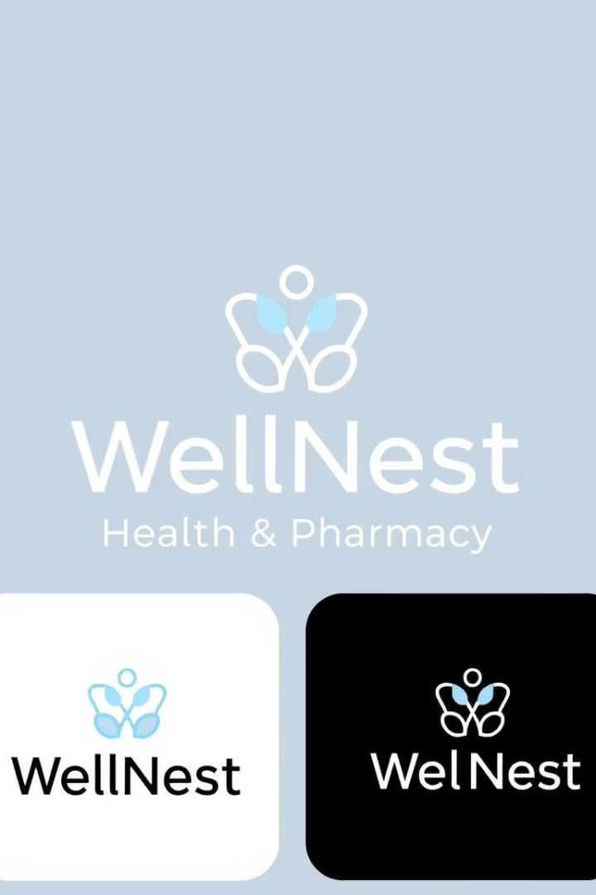
Conclusion: A Model for Modern Healthcare in Namibia
WellNest Health & Pharmacy is poised to meet the evolving healthcare needs of Windhoek through innovation, convenience, and integration. By offering digital-first services while maintaining affordability, the clinic will address gaps in both the public and private sectors, becoming a model for modern healthcare in Namibia.

Slide 9
References
Government of Namibia. (2021). Harambee Prosperity Plan II (2021–2025). Windhoek: Office of the President.
Namibia Statistics Agency (NSA). (2023). Namibia 2023 Population and Housing Census Preliminary Results. Windhoek: NSA.
.

